Slide 1
Call Projection Model BI West Team

Slide 2
Objective & Purpose
The objective of this project was to develop an historically validated call projection model that is usable in real-time going forward to call counts for call our call types.
In addition, the model needed to be adaptable and have the ability to be automated.
As of now, we have a fully-working adaptable model which automatically updates each week and can be further customized over time as needed.
Several functions (~5000 lines of code) and one script which calls these functions to run the model were programmed in ‘R’.

Slide 3
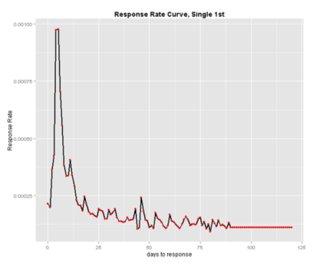
Call Model : Mktg Direct Call Count
Data used: (1) campaign tracker (campaign response) and (2) a call query to derive all past call counts.
4 historical RR curves are built for each ‘class_of_mail’ and ‘rounds’ combination by days_to_response (“Single, 1st”, “Single, 3rd”, “Multiple 1st”, “Multiple 3rd”).

Slide 4
Call Model: Mktg Direct Call Count
In addition, a separate ‘Latest INQ’ curve is built as ‘Latest INQ’ campaigns do not fit a typical highly-peaked and right-skewed response curve.
The weekday of the projection is taken into consideration via running separate linear regressions of calls on projections by day of week.
Holidays are adjusted based on past calls relative to past projections on the particular Holiday vs. an otherwise similar non-Holiday.
For each individual campaign, ‘days_of_tracking’ buckets with under total_responses = 30 unique responders are dropped as it is likely that the RR is statistically insignificant. These dropped days_of_tracking levels are imputed via linear interpolation.

Slide 5
Call Model: All other Call Counts
In addition, daily ‘DB_com’, ‘DB_IVR’, ‘iUpdate’, ‘Direct_Extension’, and ‘other’ (difference between total daily calls and calls within all distinct categories…usually 0) are projected based on three factors.
These three factors are:
(1) The mktg direct call count the same day
(2) the log of the mktg direct call count the same day (useful in case the relationship between the calls we want to project and mktg_direct_calls is non-linear)
(3) the lagged call count of the the calls we wish to project.

Slide 6

A stepwise linear regression of the call type we want to project (say ‘DB_IVR’) is run on all historical data for the day of week we wish to project.
Thus,
$DB_IVR_cal$

Slide 7
Adjustments to Raw RR Curves
For each RR curve, ‘days_of_tracking’ buckets with under 30 unique responders are dropped as it is likely that the RR is statistically insignificant– and we want to remove outliers from distorting the shape of the RR curve.
These eliminated buckets are imputed by linear interpolation between the two nearest points (averaging the nearest points).
This eliminates most kinks in the RR curves, and allows us to more reliably estimate RRs for campaign types with many ‘days_of_tracking’ levels and little past data.
These eliminated buckets are imputed by linear interpolation between the two nearest points (averaging the nearest points).

Slide 8
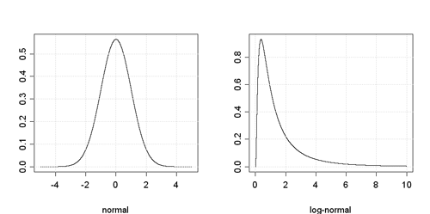
RR Curves
Notice, both fits are highly-peaked and right-skewed.
In fact, our RR curves fit a lognormal distribution quite well.
Through MLE (maximum likelihood estimation), we can find the parameters of the lognormal distribution our call model seems to fit and make our own curves each model run.
We can then test the probability that these curves are correct.
This can eliminate noise in our estimates further going forward, and may make the model more accurate.

Slide 9
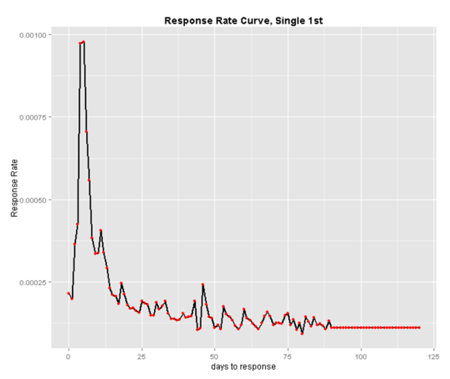
Single 1st

Slide 10
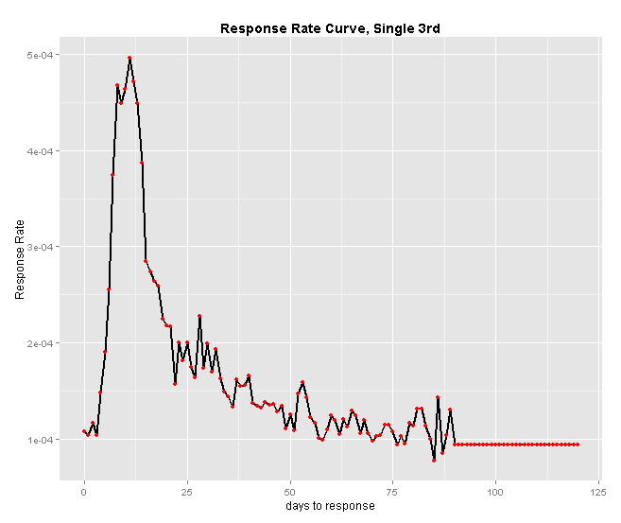
Single 3rd

Slide 11
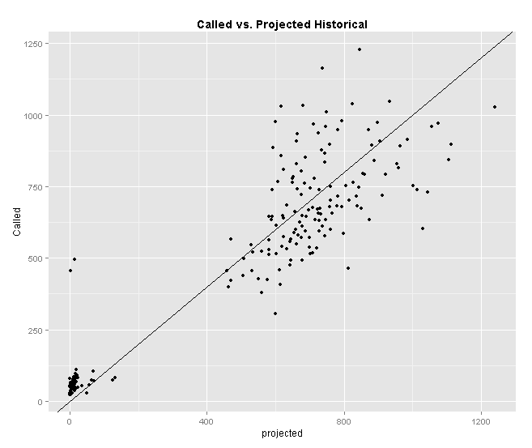
Model Performance
Daily call standard deviation of 100-150 in all months so far.
50% of days correct within 75 calls, 75% of days correct within 150 calls, & 95% of days correct within 300 calls
Call projections explain 95% of the variance in daily calls!!
Daily call standard deviation of 100-150 in all months so far.
50% of days correct within 75 calls, 75% of days correct within 150 calls, & 95% of days correct within 300 calls
Call projections explain 95% of the variance in daily calls

Slide 12
Thanks!
Questions??

